Slide 1
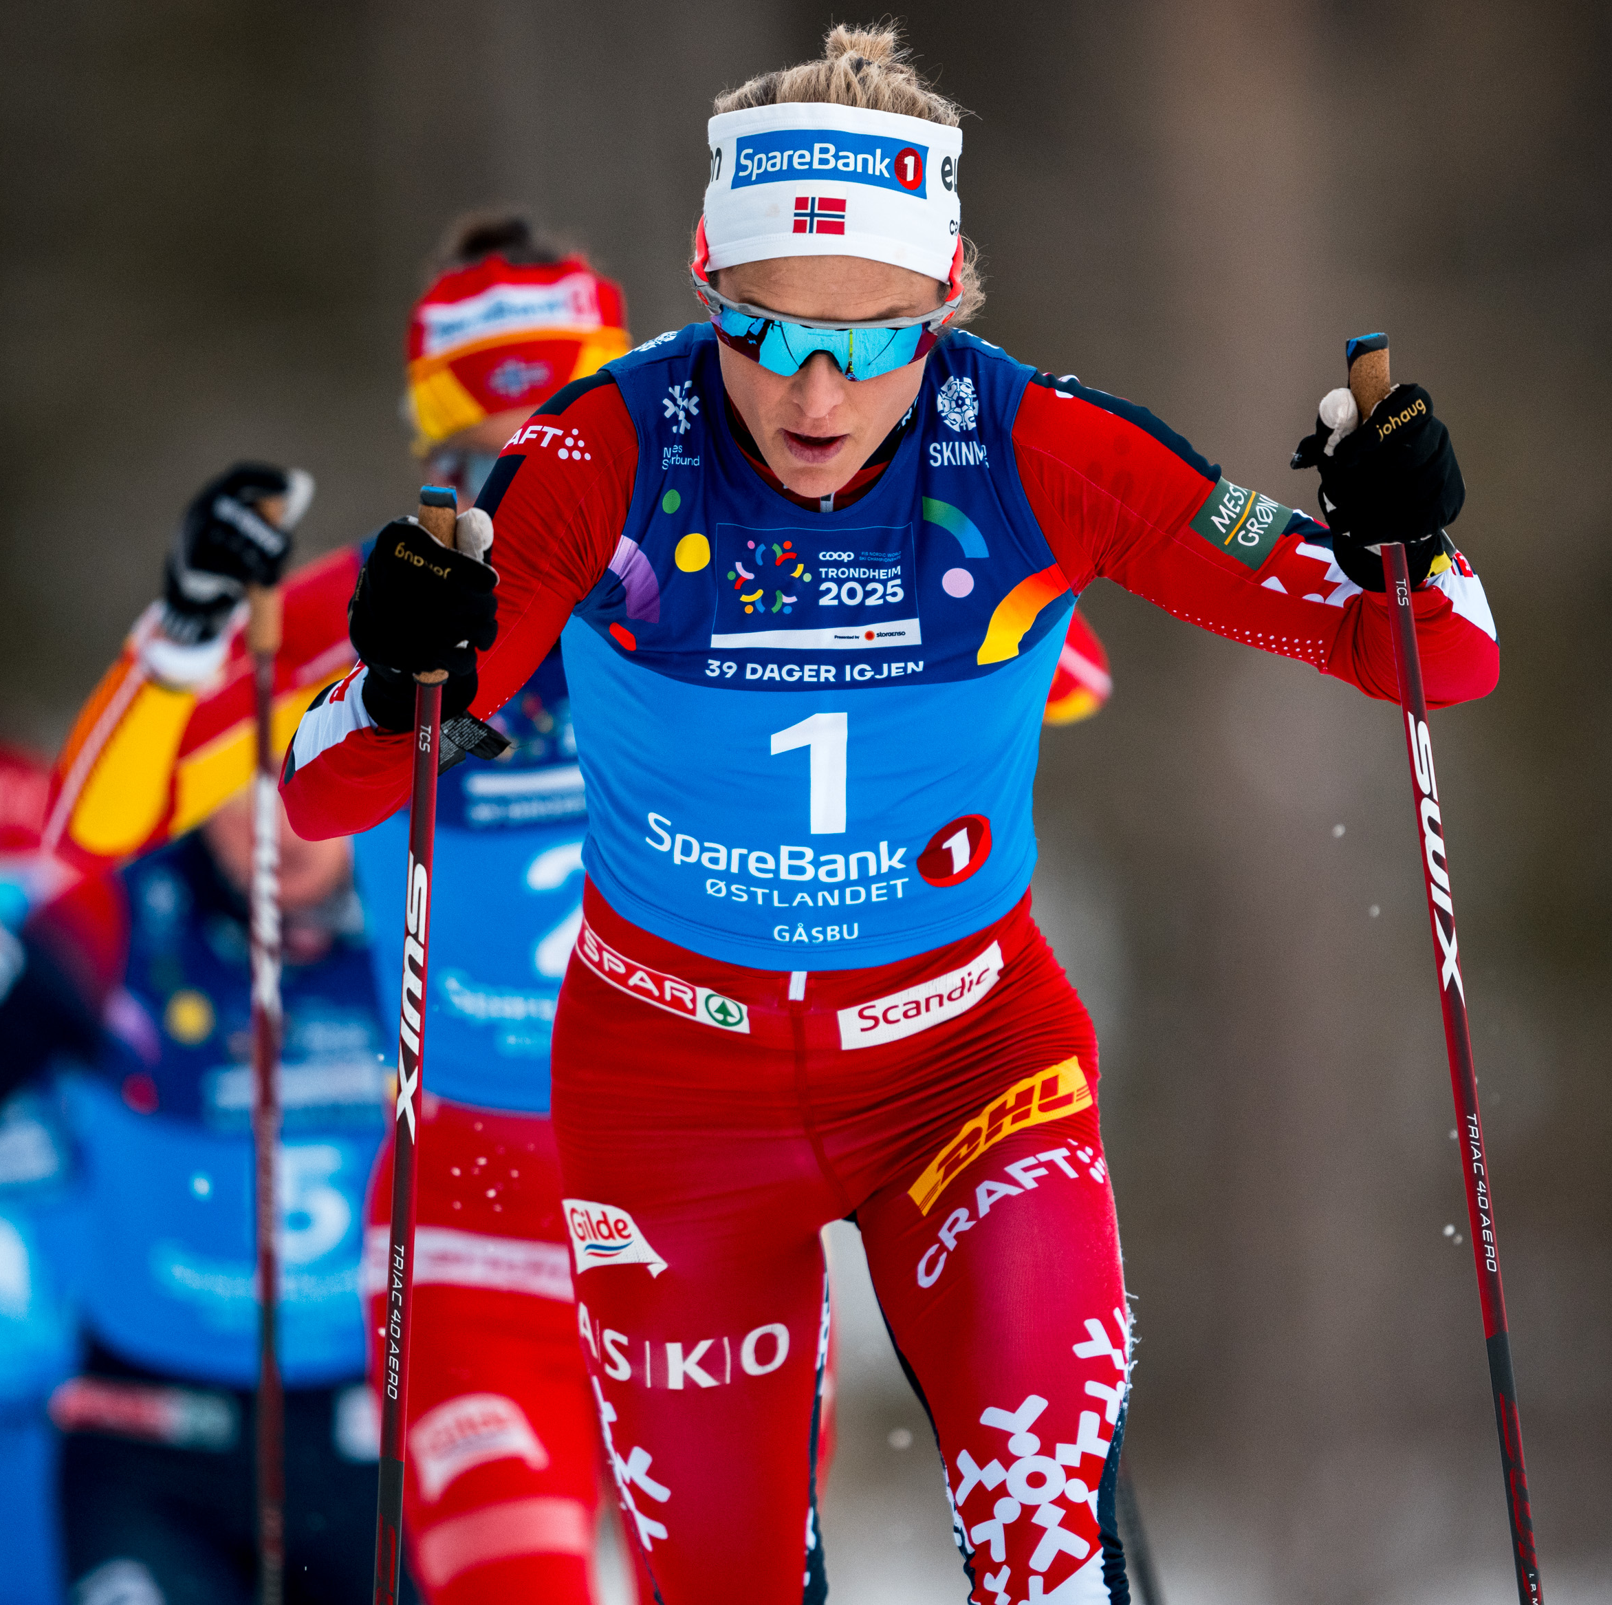


Allocation Report Fourth quarter 2024

Slide 2
In accordance with the SpareBank 1 Østlandet Green Bond Framework 2024, this document provides:
The total amount of investments and expenditures in the Eligible Green Loan Portfolio
The total amount of green funding outstanding
The balance of unallocated proceeds
Value added to the portfolio since last reporting (3Q 2024) and since inception (YE 2020)
Growth in Eligible Green Loan Portfolio last 12 months

Slide 3

Allocation Report 4Q2024
Portfolio date: 31 December 2024
¹Green covered bonds are allocated solely to green residential buildings within SpareBank 1 Boligkreditt and green senior bonds are allocated to all Use of Proceeds categories (minus green residential buildings already allocated to green covered bonds). Allocations are in line with the ICMA Green Bond Principles 2021.
²The EU Taxonomy definition of energy performance of at least 10 % lower than NZEB is currently not defined in Norwegian building standards. Residential buildings built after 2021 are therefore not included in the report.

